Slide 1
Lecture
Job Order Costing
7
L.O. 15-1: Cost Accounting Systems
L.O. 15-2: Assigning Manufacturing Costs
L.O. 15-3: Predetermined Overhead Rates
L.O. 15-4: Entries for Jobs Completed and Sold
L.O. 15-5: Applied Manufacturing Overhead

Slide 2
Learning Objective 15-1
Cost Accounting Systems

Slide 3
Outline
Process cost system
Job order cost system
Job order cost flow

Slide 4
Cost Accounting
Cost Accounting involves measuring, recording, and reporting product costs.
The objective is to provide unit cost information for pricing, cost control, inventory valuation, financial statement presentation.
Two basic types of cost accounting systems:
(1) a process cost system
(2) a job order cost system

Slide 5
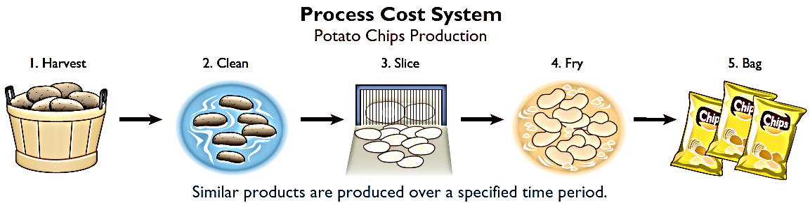
Process Cost System
Used when a large volume of similar products are manufactured (cereal, refining of petroleum, production of ice cream).
Production is continuous.
Costs are accumulated for a time period (week or month).
Costs are assigned to departments or processes for a specified period of time.

Slide 6
Job Order Cost System
Costs are assigned to each job or batch.
Each job or batch has its own distinguishing characteristics.
Objective is to compute the cost per job.
Measures costs for each job completed – not for set time periods.

Slide 7
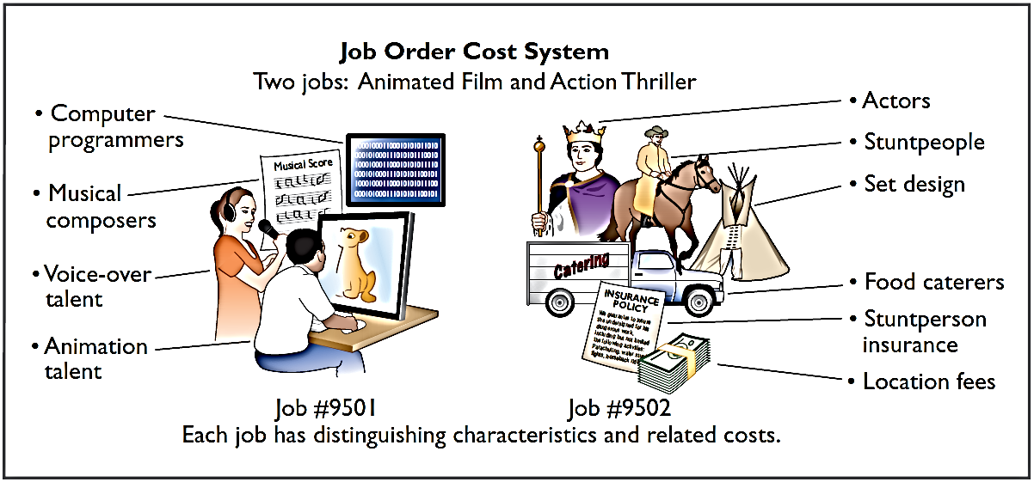
Job Order Cost System
Job order cost system for Disney as it produced two different films.

Slide 8
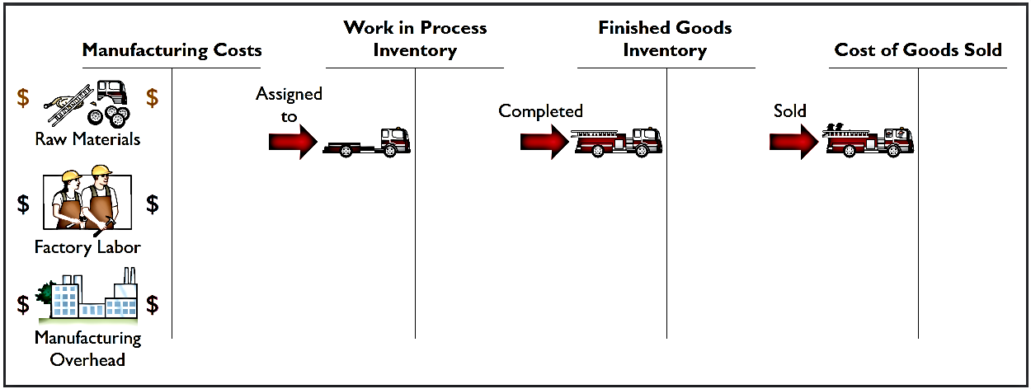
Job Order Cost Flow
The flow of costs parallels the physical flow of the materials as they are converted into finished goods.
Companies first accumulate manufacturing costs and they then assign the costs to the work done.
Accumulation
Assignment

Slide 9
Accumulating Manufacturing Costs
Raw Material Costs
Illustration: Wallace Company purchases, on account, 2,000 lithium batteries (Stock No. AA2746) at $5 per unit ($10,000) and 800 electronic modules (Stock No. AA2850) at $40 per unit ($32,000) for a total cost of $42,000 ($10,000 + $32,000). The entry to record this purchase on January 4 is:
Jan. 4 | Raw Materials Inventory | 42,000
 | Accounts Payable | 42,000

Slide 10
Accumulating Manufacturing Costs
Factory Labor Costs
Consists of three costs:
Gross earnings of factory workers
Employer payroll taxes on these wages
Fringe benefits (such as sick pay, pensions, and vacation pay) incurred by the employer

Slide 11
Accumulating Manufacturing Costs
Factory Labor Costs
Illustration: Wallace incurs $32,000 of factory labor costs. The entry to record factory labor (both direct and indirect) for the month is:
Jan. 31 | Factory Labor | 32,000
 | Payroll Liabilities | 32,000

Slide 12
Accumulating Manufacturing Costs
Manufacturing Overhead Costs
Many types of overhead costs
Property taxes, depreciation, insurance, and repairs related to the manufacturing process
Costs unrelated to manufacturing are expensed as period costs
Costs related to manufacturing process are accumulated in the Manufacturing Overhead account
Manufacturing overhead subsequently assigned to work in process

Slide 13
Accumulating Manufacturing Costs
Manufacturing Overhead Costs
Illustration: Using assumed data, the summary entry for manufacturing overhead (other than indirect materials and indirect labor) in Wallace Company is:
Jan. 31 | Manufacturing Overhead | 13,800
 | Utilities Payable | 4,800
 | Prepaid Insurance | 2,000
 | Accounts Payable (for repairs) | 2,600
 | Accumulated Depreciation | 3,000
 | Property Taxes Payable | 1,400

Slide 14
DO IT! 1: Accumulating Manufacturing Costs
During the current month, Ringling Company incurs the following manufacturing costs:
1. Raw material purchases of $4,200 on account.
2. Factory labor of $18,000.
3. Factory utilities of $2,200 are payable, prepaid factory insurance of $1,800 has expired, and depreciation on the factory building is $3,500.
Prepare journal entries for each type of manufacturing cost.

Slide 15
DO IT! 1: Accumulating Manufacturing Costs
1. Raw material purchases of $4,200 on account.
Raw Materials Inventory | 4,200
Accounts Payable | 4,200
2. Factory labor of $18,000.
Factory Labor | 18,000
Payroll Liabilities | 18,000
3. Factory utilities of $2,200 are payable, prepaid factory insurance of $1,800 has expired, and depreciation on the factory building is $3,500.
Manufacturing Overhead | 7,500
Utilities Payable | 2,200
Prepaid Insurance | 1,800
Accumulated Depreciation | 3,500

Slide 16
Learning Objective 15-2
Assigning Manufacturing Costs

Slide 17
Outline
Raw materials costs
Factory labor costs

Slide 18
Assigning Manufacturing Costs
Assigning manufacturing costs to work in process results in the following entries.
Increases to Work in Process Inventory
Decreases to
Raw Materials Inventory
Factory Labor
Manufacturing Overhead

Slide 19
Assigning Manufacturing Costs
Job Cost Sheet
Used to record costs chargeable to specific jobs
Constitutes subsidiary ledger for work in process account
Each increase or decrease to Work in Process Inventory must be accompanied by a corresponding posting to one or more job cost sheets

Slide 20
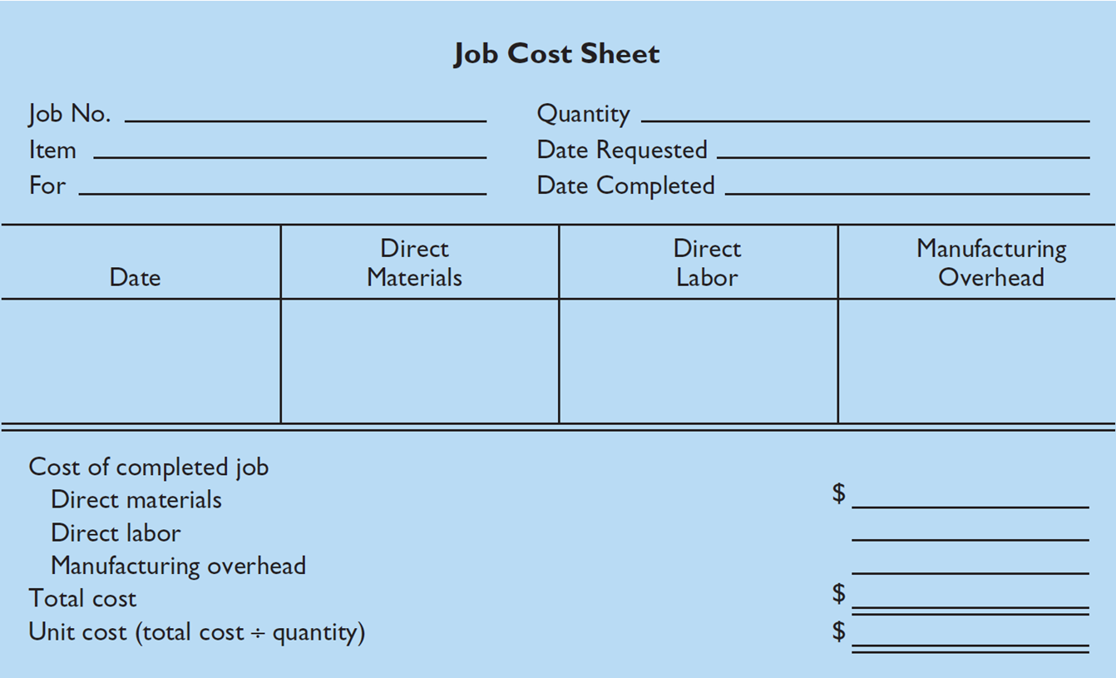
Assigning Manufacturing Costs
Example of Job Cost Sheet

Slide 21
Raw Material Costs
Assigned to a job when materials are issued in response to requests.
Materials requisition slip
Written authorization for issuing raw materials
May be directly issued to use on a job - direct materials (charged to Work in Process Inventory)
May be considered indirect materials – charged to Manufacturing Overhead

Slide 22
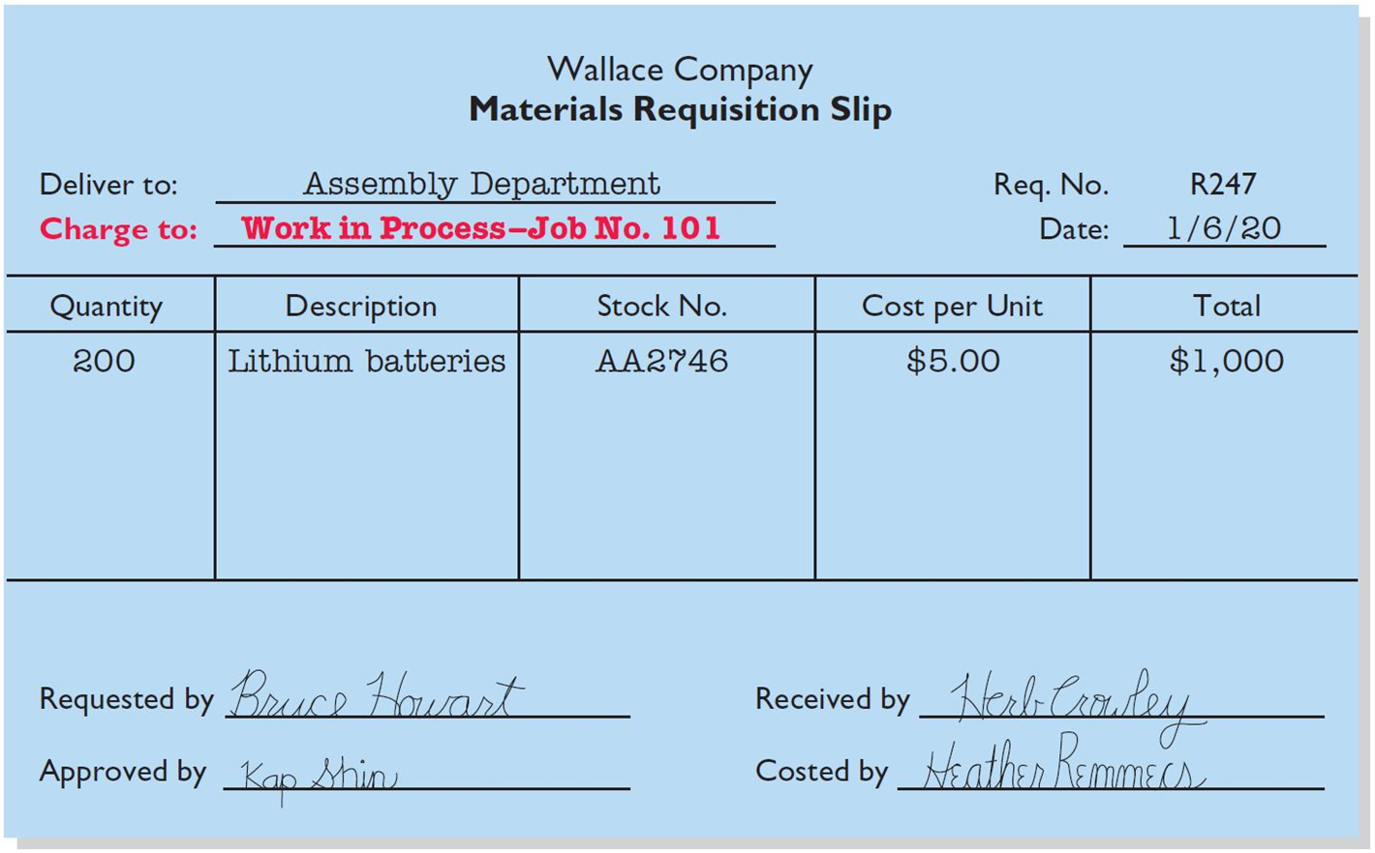
Raw Material Costs
Materials Requisition Slip

Slide 23
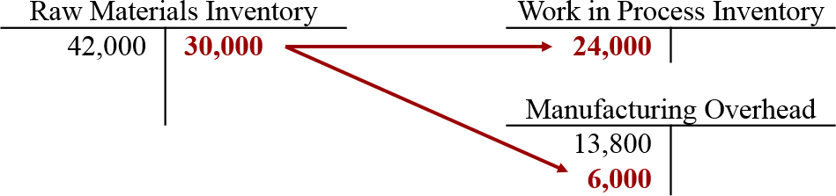
Raw Material Costs
Journal entry for direct and indirect materials
Illustration: Wallace uses $24,000 of direct materials and $6,000 of indirect materials in January as shown.
Jan. 31 Work in Process Inventory 24,000
Manufacturing Overhead 6,000
Raw Materials Inventory 30,000

Slide 24
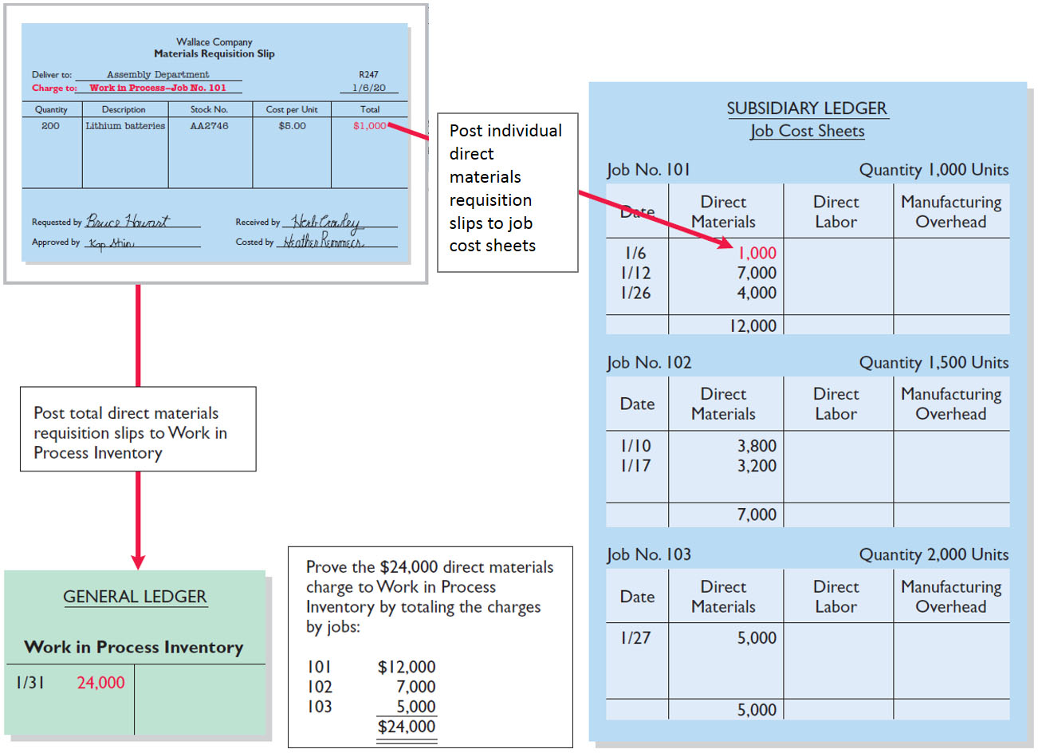
Raw Material Costs
Posting to general ledger and subsidiary ledger

Slide 25
Factory Labor Costs
Assigned to jobs on basis of time tickets
Time tickets are prepared when work is performed
Time tickets indicate:
Employee
Hours worked
Account and job charged
Total labor cost

Slide 26
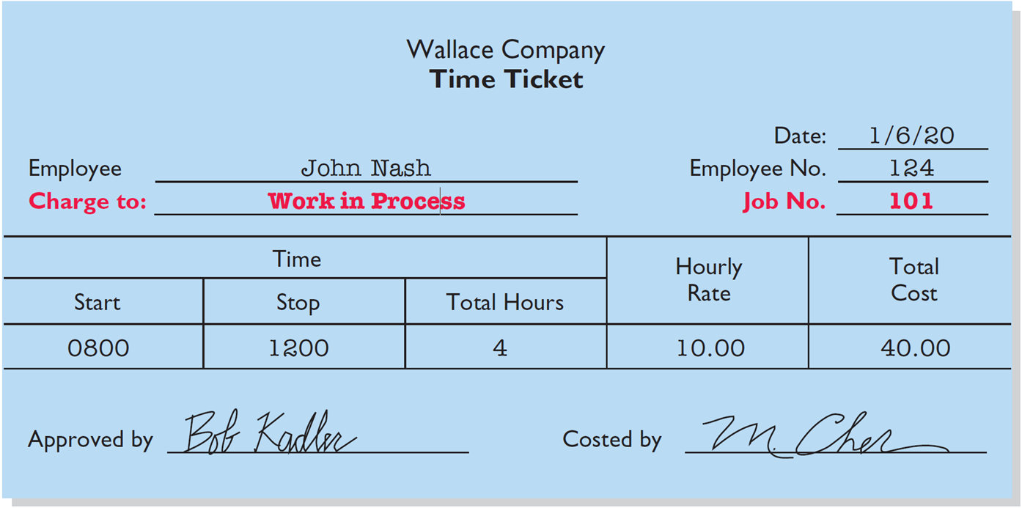
Factory Labor Costs
Time ticket

Slide 27
Factory Labor Costs
Journal entry for direct and indirect labor
Illustration: The time tickets are later sent to the payroll department, which applies the employee’s hourly wage rate and computes the total labor cost. If the $32,000 total factory labor cost consists of $28,000 of direct labor and $4,000 of indirect labor, the entry is:
Jan. 31 Work in Process Inventory 28,000
Manufacturing Overhead 4,000
Factory Labor 32,000

Slide 28
Factory Labor Costs
Posting labor journal entry to general ledger
Jan. 31 Work in Process Inventory 28,000
Manufacturing Overhead 4,000
Factory Labor 32,000

Slide 29
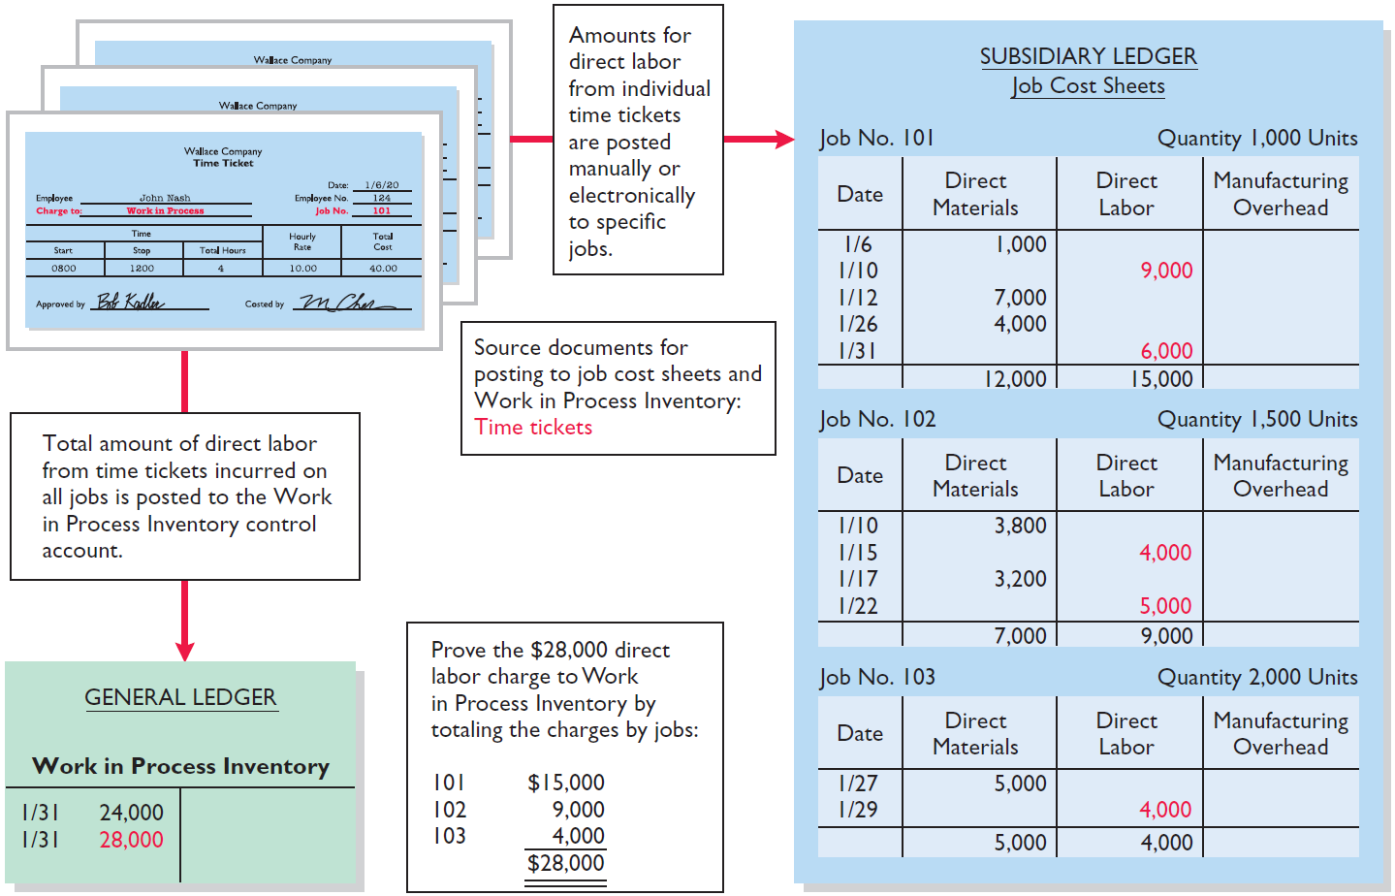
Factory Labor Costs
Posting to general ledger and subsidiary ledger

Slide 30
DO IT! 2: Work in Process
Danielle Company is working on two job orders. The job cost sheets show the following:
Direct materials - Job 120 $6,000; Job 121 $3,600
Direct labor - Job 120 $4,000; Job 121 $2,000
Manufacturing overhead - Job 120 $5,000; Job 121 $2,500
Prepare the three summary entries to record the assignment of costs to work in process from the data on the job cost sheets.

Slide 31
DO IT! 2: Work in Process
Journal entry for direct materials
Direct materials - Job 120 $6,000; Job 121 $3,600
Work in Process Inventory 9,600
Raw Materials Inventory 9,600
Journal entry for direct labor
Direct labor - Job 120 $4,000; Job 121 $2,000
Work in Process Inventory 6,000
Factory Labor 6,000
Journal entry for manufacturing overhead
Manufacturing overhead - Job 120 $5,000; Job 121 $2,500
Work in Process Inventory 7,500
Manufacturing Overhead 7,500

Slide 32
Learning Objective 15-3
Predetermined Overhead Rates

Slide 33
Outline
Predetermined overhead rate
Applying manufacturing overhead

Slide 34
Manufacturing Overhead Costs
Relates to production operations as a whole
Cannot be assigned to specific jobs based on actual costs incurred
Companies assign to work in process and to specific jobs on an estimated basis through the use of a Predetermined Overhead Rate

Slide 35
Predetermined Overhead Rate
Based on relationship between estimated annual overhead costs and expected annual operating activity.
Expressed in terms of an activity base such as:
Direct labor costs
Direct labor hours
Machine hours
Any other measure that provides an equitable basis for applying overhead costs
Established at the beginning of the year

Slide 36
Predetermined Overhead Rate
Formula of predetermined overhead rate
Small companies often use a single, company-wide predetermined rate
Large companies often use a different rate for each department and each department may have a different activity base
Formula for computing the predetermined rate overhead rate is:

Slide 37
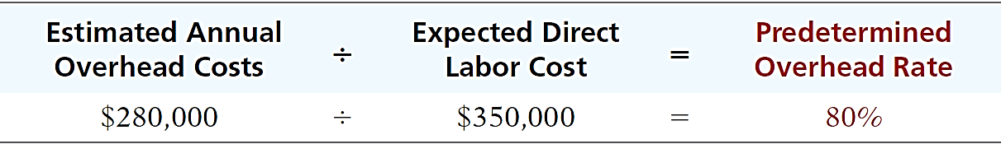
Predetermined Overhead Rate
Calculation of predetermined overhead rate
Illustration: Wallace Company uses direct labor cost as the activity base. Assuming that the company expects annual overhead costs to be $280,000 and direct labor costs for the year to be $350,000, compute the overhead rate.
This means that for every dollar of direct labor, Wallace will assign _________ of manufacturing overhead to a job.
80 cents

Slide 38
Predetermined Overhead Rate
Journal entry to apply overhead
Illustration: Wallace applies manufacturing overhead to work in process when it assigns direct labor costs. Calculate the amount of applied overhead assuming direct labor costs were $28,000.
$28,000 x 80% = $22,400
The following entry records this application.
Jan. 31 Work in Process Inventory 22,400
Manufacturing Overhead 22,400

Slide 39
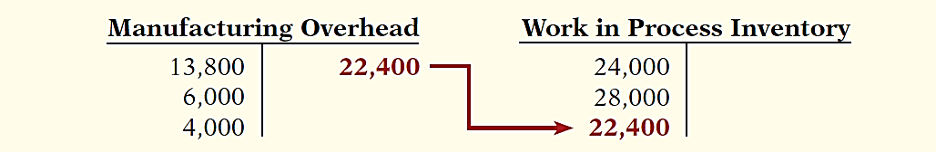
Predetermined Overhead Rate
Posting applied overhead to general ledger
The following entry records this application.
Jan. 31 Work in Process Inventory 22,400
Manufacturing Overhead 22,400
This entry reduces the balance in Manufacturing Overhead and increases Work in Process Inventory by $22,400.

Slide 40
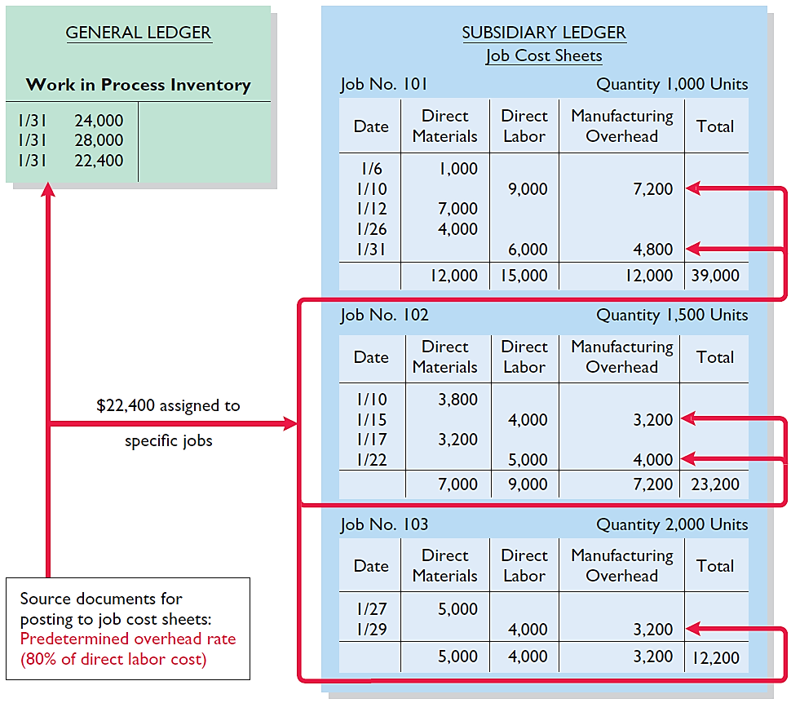
Predetermined Overhead Rate
Posting applied overhead to subsidiary ledger
The sum of the manufacturing overhead columns of the job cost sheets should equal the manufacturing overhead debited (i.e. applied) to Work in Process Inventory.

Slide 41
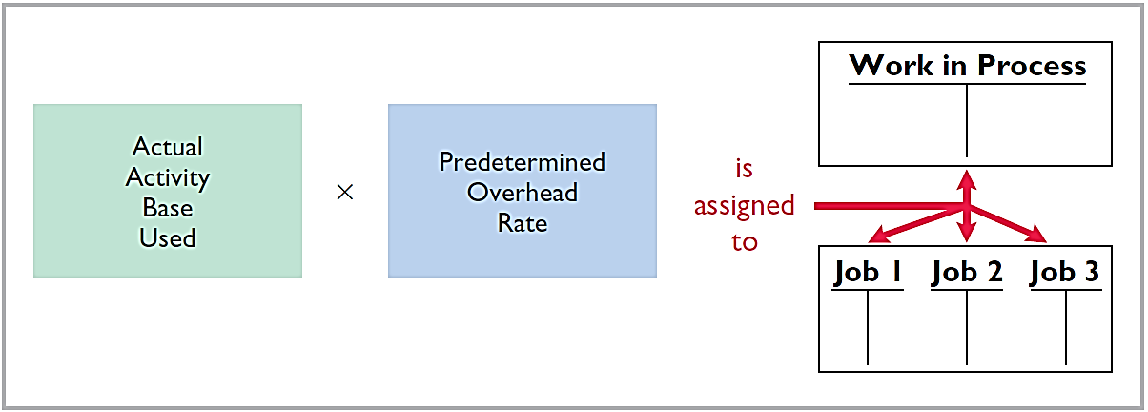
Predetermined Overhead Rate
Manufacturing overhead costs are assigned to Work in Process during the period to get timely information about the cost of a completed job.

Slide 42
DO IT! 3: Predetermined Overhead Rate
Stanley Company produces specialized safety devices. For the year, manufacturing overhead costs are expected to be $160,000. Expected machine usage is 40,000 hours. The company assigns overhead based on machine hours. Job No. 302 used 2,000 machine hours.
Compute the predetermined overhead rate.
Solution
$160,000 ÷ 40,000 hours = $4.00 per machine hour

Slide 43
DO IT! 3: Predetermined Overhead Rate
Stanley Company produces specialized safety devices. For the year, manufacturing overhead costs are expected to be $160,000. Expected machine usage is 40,000 hours. The company assigns overhead based on machine hours. Job No. 302 used 2,000 machine hours.
Determine the amount of overhead to allocate to Job No. 302.
Solution
2,000 hours x $4.00 = $8,000

Slide 44
DO IT! 3: Predetermined Overhead Rate
Stanley Company produces specialized safety devices. For the year, manufacturing overhead costs are expected to be $160,000. Expected machine usage is 40,000 hours. The company assigns overhead based on machine hours. Job No. 302 used 2,000 machine hours.
Prepare the entry to assign overhead to Job No. 302 on March 31.
Solution
Work in Process Inventory 8,000
Manufacturing Overhead 8,000

Slide 45
Learning Objective 15-4
Entries for Jobs Completed and Sold

Slide 46
Outline
Finished goods
Cost of goods sold
Summary of job order cost flows
Job order for service companies
Advantages and disadvantages of job order costing

Slide 47
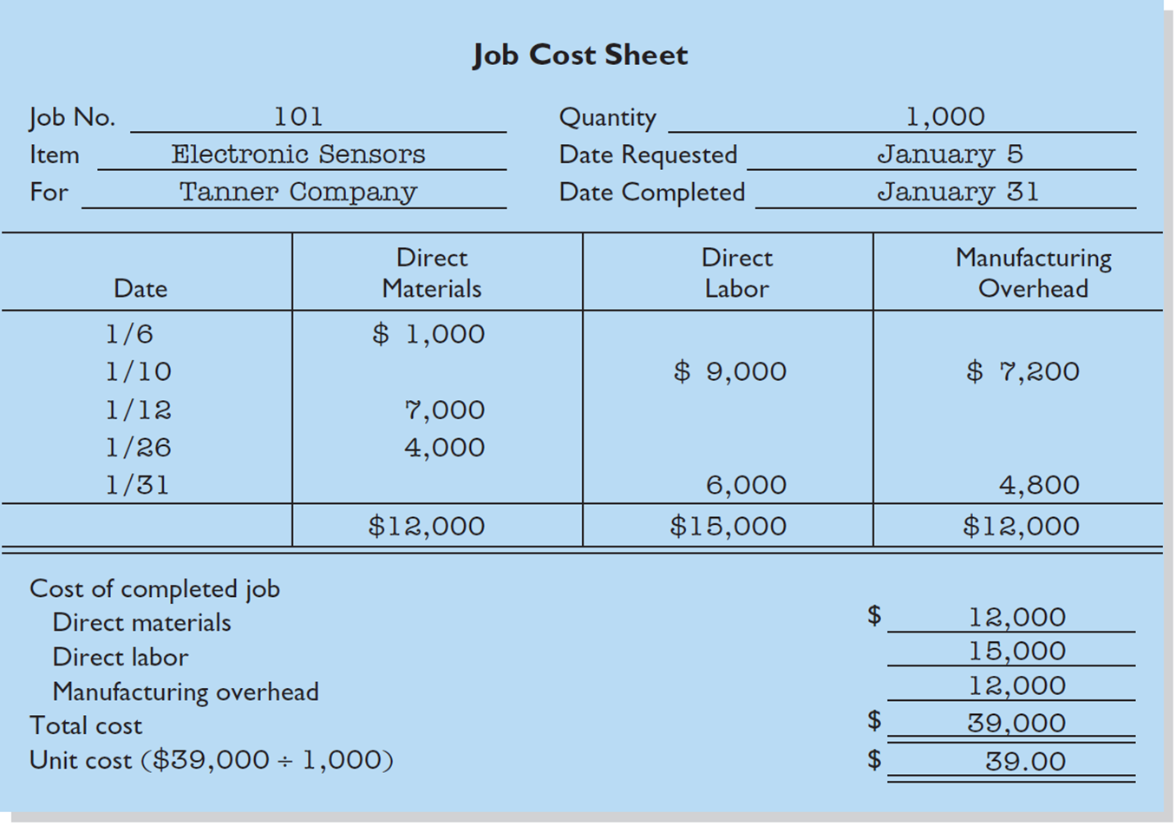
Completed Job Cost Sheet
When a job is completed, Wallace Company summarizes the costs and completes the lower portion of the applicable job cost sheet.

Slide 48
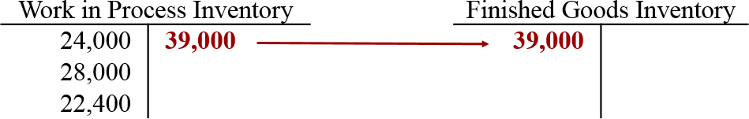
Assigning Costs to Finished Goods
When a job is finished, Wallace transfers total cost to finished goods inventory. Recording the finished job as shown.
Jan. 31 Finished Goods Inventory 39,000
Work in Process Inventory 39,000

Slide 49
Assigning Costs to Finished Goods
Journal entries to sell goods and record cost of sales
On January 31 Wallace Company sells on account Job No. 101 for $50,000. The job cost $39,000. Recording the sale as follows.
Jan. 31 Accounts Receivable 50,000
Sales revenue 50,000
Cost of Goods Sold 39,000
Finished Goods Inventory 39,000

Slide 50
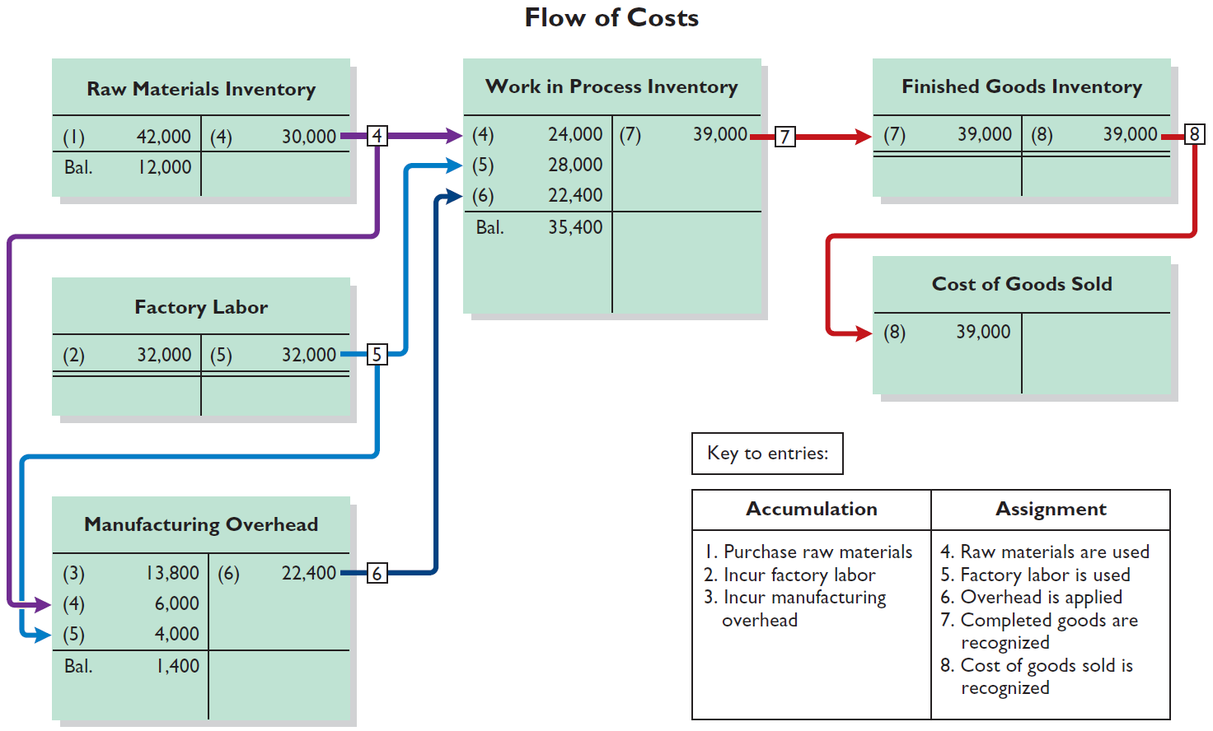
Assigning Costs to Finished Goods
Flow of costs through the general ledger accounts

Slide 51
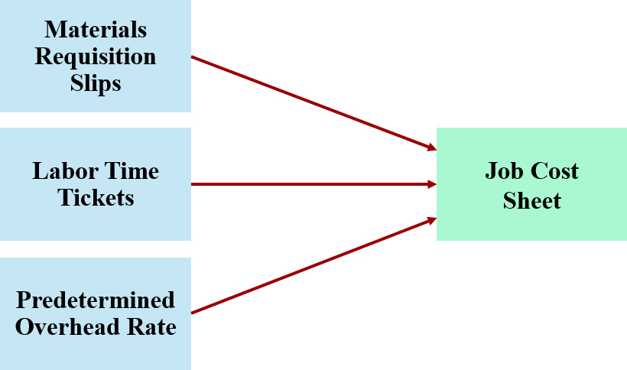
Summary of Job Order Cost Flows
The job cost sheet summarizes the cost of jobs completed and not completed at the end of the accounting period.
Jobs completed are transferred to finished goods to await sale.

Slide 52
Job Order Costing for Service Companies
While service companies do not have inventory, techniques of job order costing are still quite useful in many service-industry environments.
Consider, for example, the Mayo Clinic (health care), PricewaterhouseCoopers (accounting), and Goldman Sachs (investment banking).
These companies need to keep track of the cost of jobs performed for specific customers to evaluate profitability of medical treatments, audits, or investment banking engagements.

Slide 53
Job Order Costing for Service Companies
Assignment of supplies
Illustration: Dorm Decor, an interior design company. The entry to record the assignment of $9,000 of supplies to projects ($7,000 direct and $2,000 indirect) is:
Service Contracts in Process 7,000
Operating Overhead 2,000
Supplies 9,000

Slide 54
Job Order Costing for Service Companies
Assignment of direct and indirect labor
Illustration: Dorm Decor, an interior design company. The entry to record the assignment of service salaries and wages of $100,000 ($84,000 direct and $16,000 indirect) is:
Service Contracts in Process 84,000
Operating Overhead 16,000
Service Salaries and Wages 100,000

Slide 55
Job Order Costing for Service Companies
Assignment of direct and indirect labor
Illustration: Dorm Decor, an interior design company. Dorm Decor applies operating overhead at a rate of 50% of direct labor costs. The entry to record the application of overhead ($84,000 × 50%) based on the $84,000 of direct labor costs is:
Service Contracts in Process 42,000
Operating Overhead 42,000

Slide 56
Advantages and Disadvantages of Job Order Costing
Advantages
More precise assignment of costs to projects than process costing
Provides more useful information for determining profitability of particular projects and for estimating costs when preparing bids on future jobs
Disadvantage
Requires a significant amount of data entry

Slide 57
Do It! 4: Completion and Sale of Jobs
Onyx Corporation completed Job 109 and Job 112. Job 109 cost $19,000 and Job 112 costs $27,000. Job 112 was sold on account for $42,000. Journalize the entries for the completion of the two jobs and the sale of Job 112.
Finished Goods Inventory 46,000
Work in Process Inventory 46,000
Accounts Receivable 42,000
Sales Revenue 42,000
Cost of Goods Sold 27,000
Finished Goods Inventory 27,000

Slide 58
Learning Objective 15-5
Applied Manufacturing Overhead

Slide 59
Outline
Under- or overapplied manufacturing overhead

Slide 60
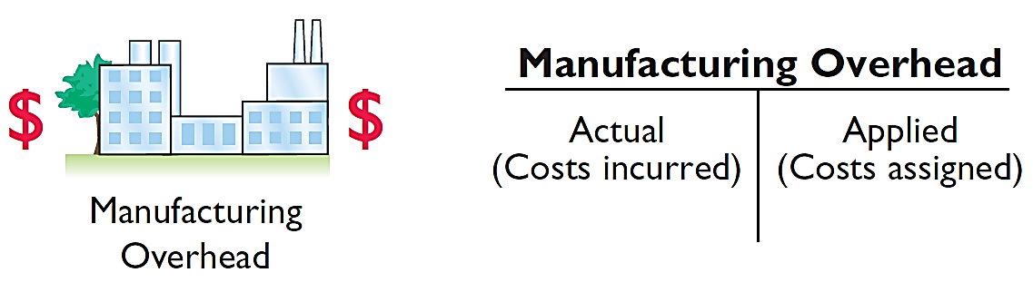
Under- or Overapplied Manufacturing Overhead
A debit balance in manufacturing overhead means that overhead is underapplied
A credit balance in manufacturing overhead means that overhead is overapplied

Slide 61
Under- or Overapplied Manufacturing Overhead
Eliminating year-end balance in manufacturing overhead
Any Year-End Balance in manufacturing overhead is eliminated by adjusting cost of goods sold.
Underapplied overhead is debited to COGS
Overapplied overhead is credited to COGS

Slide 62
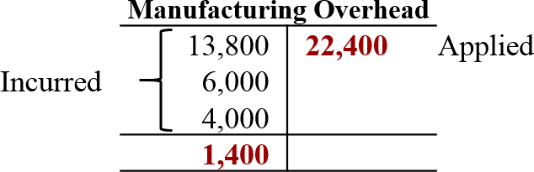
Under- or Overapplied Manufacturing Overhead
Adjusting entry for under-applied overhead
Illustration: Wallace has a $1,400 debit balance in Manufacturing Overhead at December 31. The adjusting entry for the under-applied overhead is:
Dec. 31 Cost of Goods Sold 1,400
Manufacturing Overhead 1,400

Slide 63
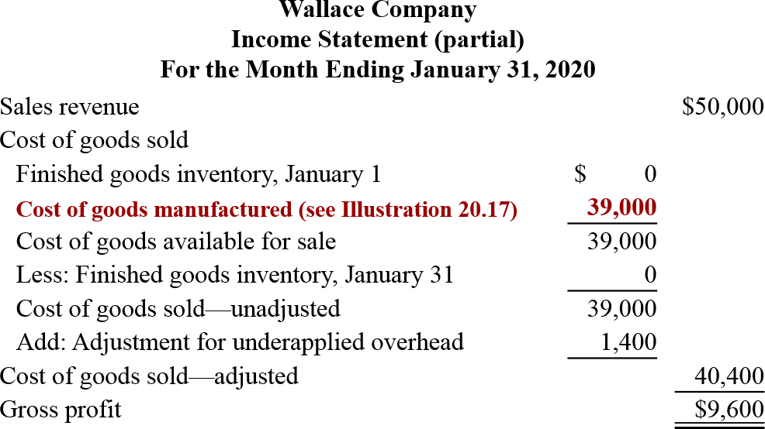
Under- or Overapplied Manufacturing Overhead
Partial income statement

Slide 64
Do It! 5: Applied Manufacturing Overhead
For Karr Company, the predetermined overhead rate is 140% of direct labor cost. During the month, Karr incurred $90,000 of factory labor costs, of which $80,000 is direct labor and $10,000 is indirect labor. Actual overhead incurred was $119,000.
Compute the amount of manufacturing overhead applied during the month.
(140% × $80,000) = $112,000
Determine the amount of under- or overapplied manufacturing overhead.
($119,000 − $112,000) = $7,000
(Underapplied)

